Slide 1
The KPI
The KPI

Slide 2
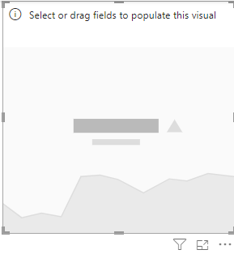
The KPI
Note: This lab uses Sales database
Add KPI visual into the scene

Slide 3
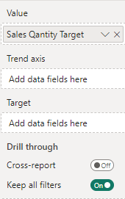
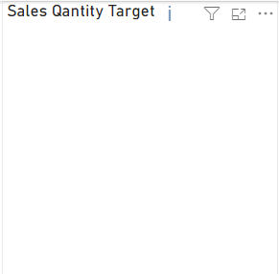
The KPI
Note: This lab uses Sales database
Try to add SalesQuantity to Value field and observe the i sign

Slide 4
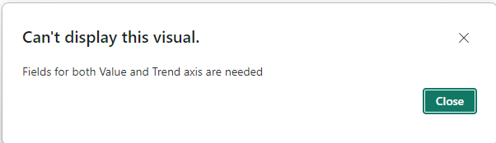
The KPI
Do a mouse hover on the i sign and click it

Slide 5
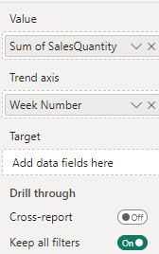
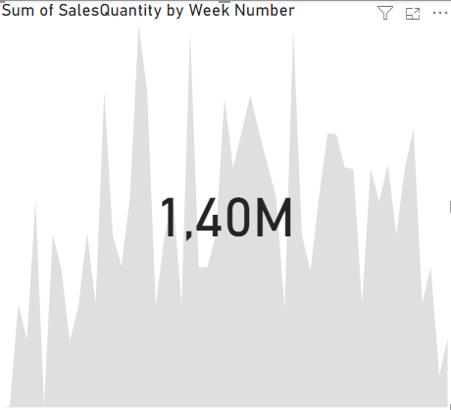
The KPI
Create a calculated column at the DimDate level and name it Week Number
Week Number = WEEKNUM(DimDate[Date])
Add that calculated column at the Tend Axis level and observe the changes

Slide 6
The KPI
Now the Target need to be added , for that we have to create a measure that represents our goal

Slide 7
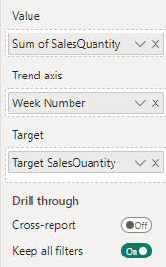
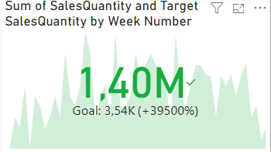
The KPI
Then we create two measures for test
Target SalesQuantity = AVERAGE(FactSales[SalesQuantity])
Target ReturnQuantity = AVERAGE(FactSales[ReturnQuantity])
First configure the KPI visual as Follow

Slide 8
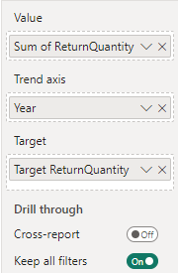
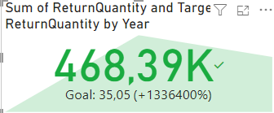
The KPI
Add a second KPI visual as Follow and observe the behavior

Slide 9
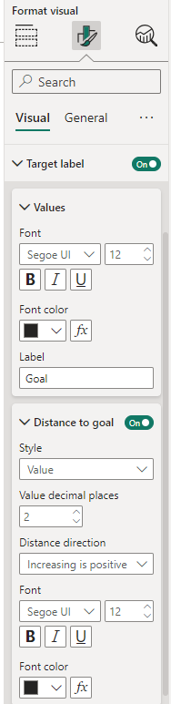
The KPI
Change the label value to be not a percentage

Slide 10
The Custom KPI

Slide 11
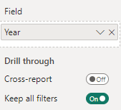
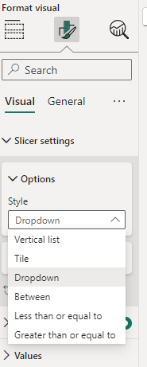
The KPI
Let’s see how to create custom KPI now
First create a slicer and configure it to show the Year field from DimDate

Slide 12
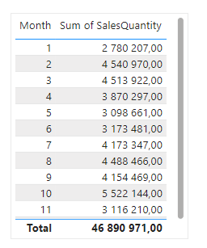
The KPI
Then add a Table visual with Month field from DimDate and SalesQuantity from FactSales

Slide 13
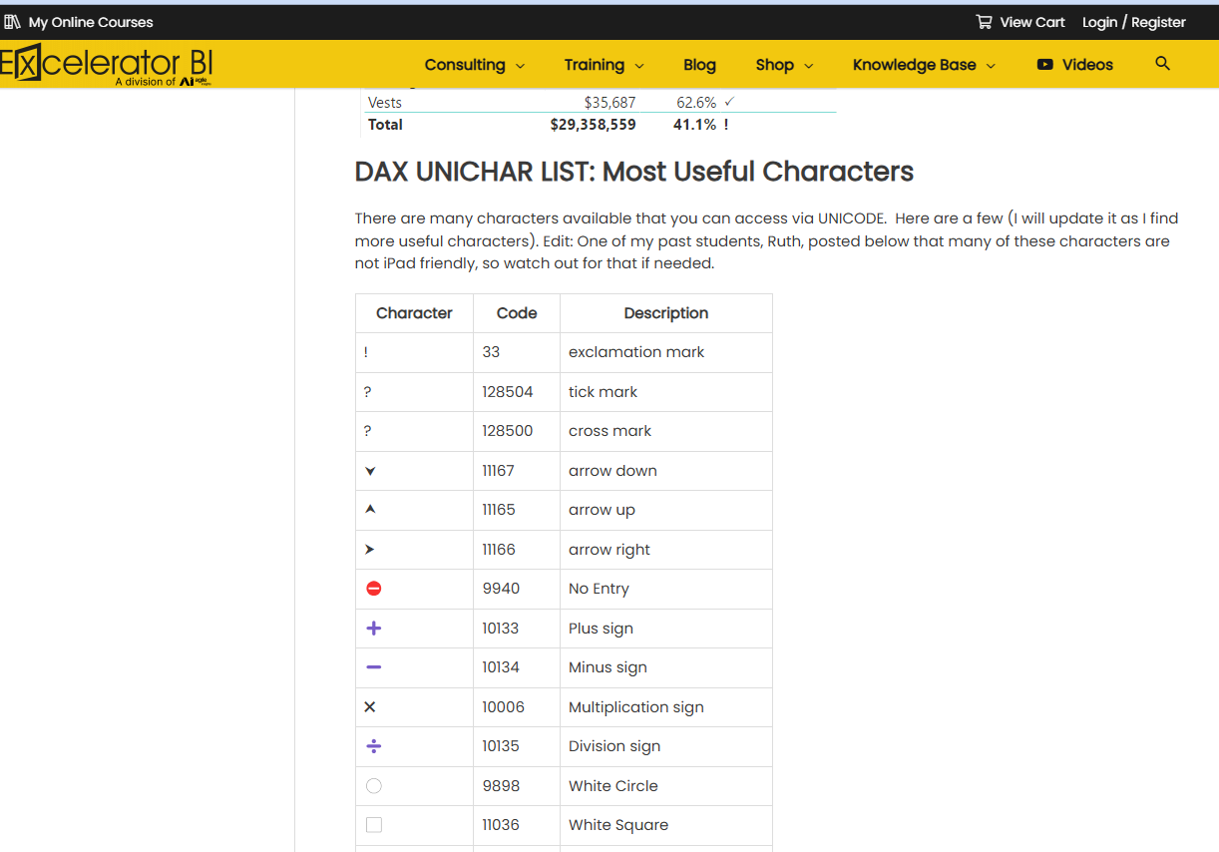
The KPI
Let’s create a measure that represents the KPI indicator, first make a visit to this site
https://exceleratorbi.com.au/dax-unichar-function-power-bi/

Slide 14
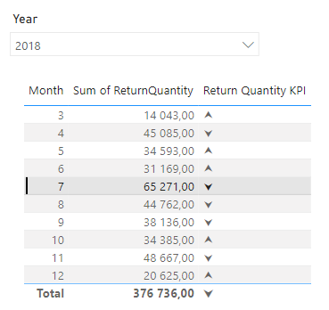
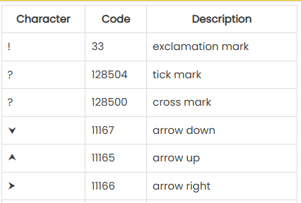
The KPI
The above site is used to generate special indicators forms that are useful for the Power BI visuals
especially the Power bi custom KPI
Return Quantity KPI = IF(SUM(FactSales[ReturnQuantity])>38000=TRUE(),UNICHAR(11167),UNICHAR(11165))
The above measure compare the amount of the return quantity to a threshold which is 38000
Codes table from
exceleratorbi.com.au

Slide 15
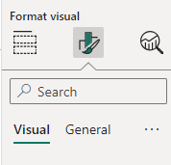
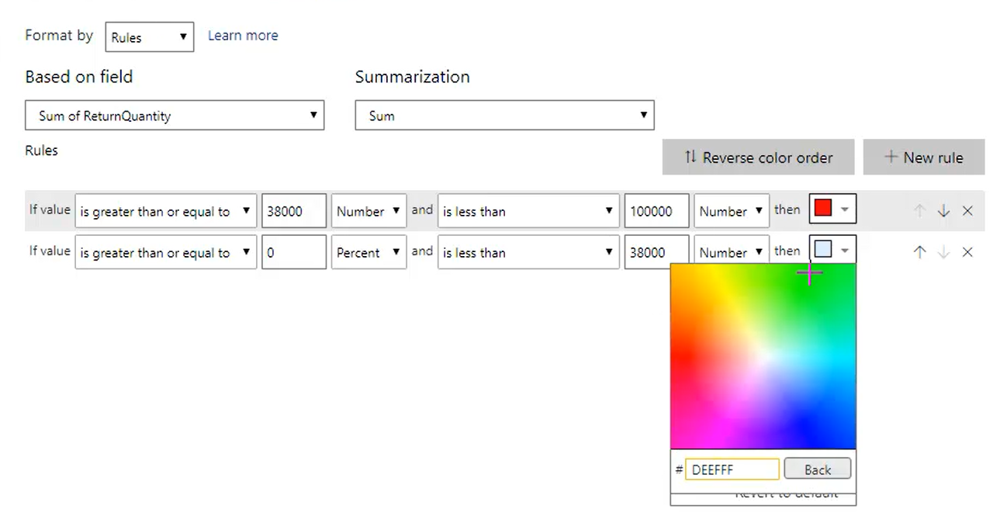
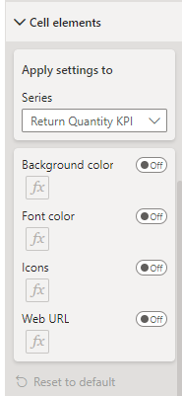
The KPI
We can make the indicator more convivial by adding a formatting condition on the font color of the indicators

Slide 16
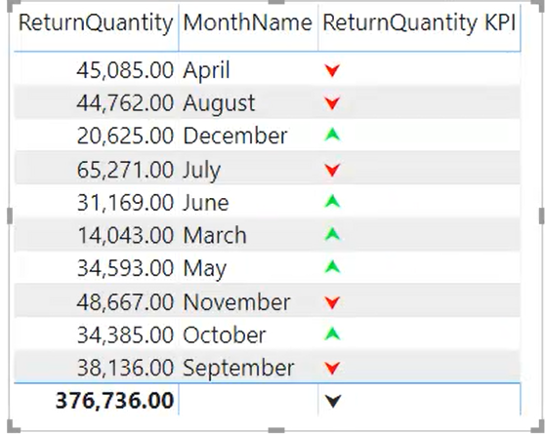
The KPI
We can make the indicator more convivial by adding a formatting condition on the font color of the indicators

Slide 17
Thank you
Thank you

